Slide 1
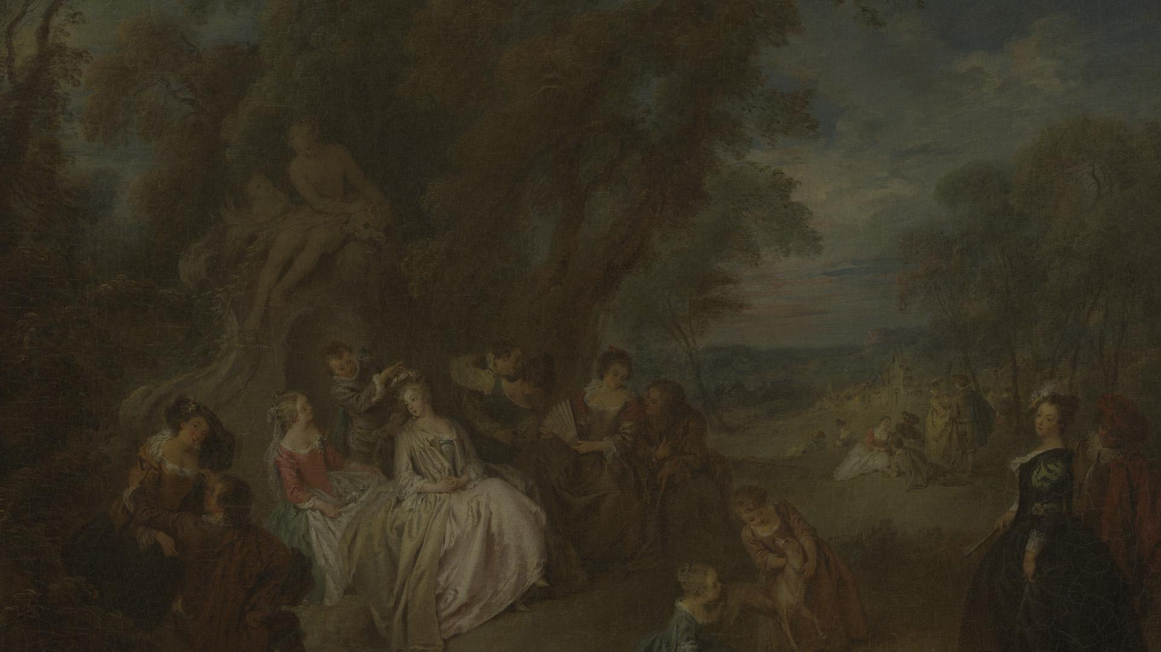
Language arts subject for high school. Dark Romanticism: American Gothic
Here is where your presentation begins

Slide 2
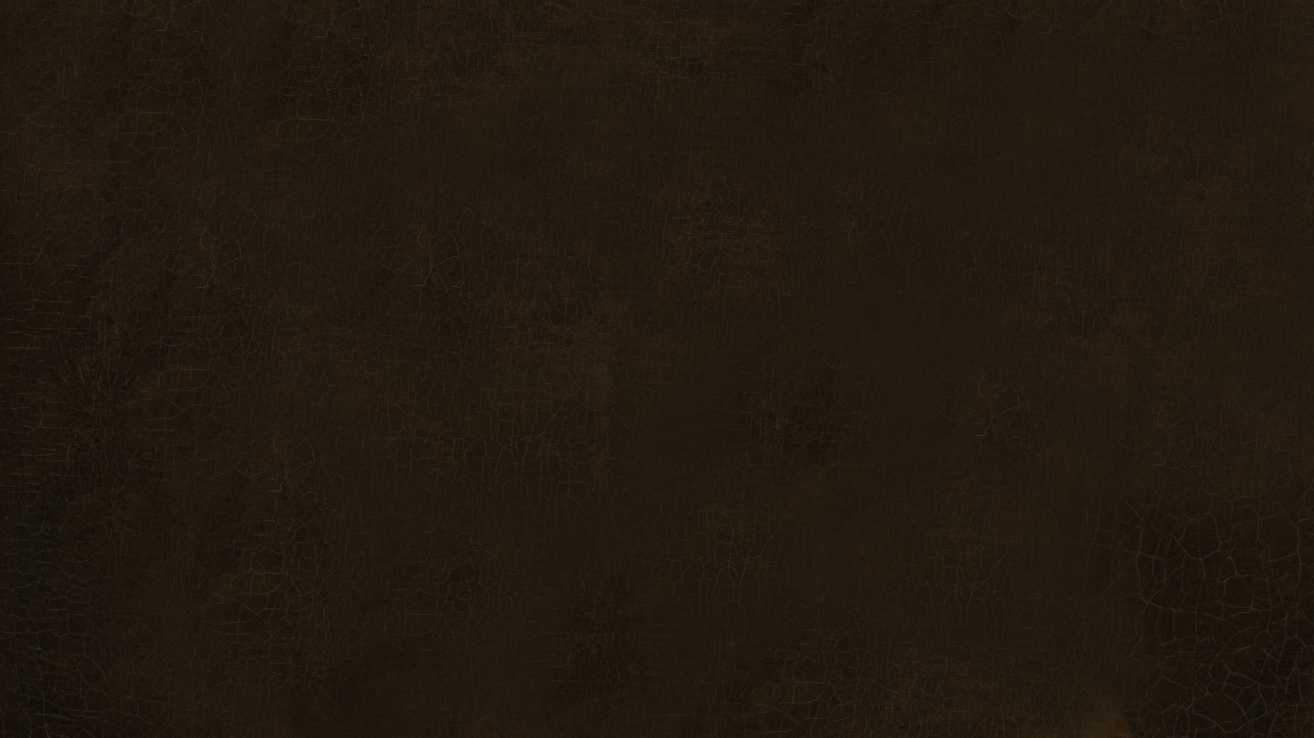
Contents of this template
Here’s what you’ll find in this Slidesgo template:
A slide structure based on a multi-purpose presentation for education, which you can easily adapt to your needs. For more info on how to edit the template, please visit Slidesgo School or read our FAQs.
To view this template in PowerPoint with the correct fonts, download and install on your computer the fonts that we have used. You can learn how to download and install fonts here.
An assortment of graphic resources that are suitable for use in the presentation can be found in the alternative resources slide.
A thanks slide, which you must keep so that proper credits for our design are given.
A resources slide, where you’ll find links to all the elements used in the template.
Instructions for use.
Final slides with:
The fonts and colors used in the template.
A selection of illustrations. You can also customize and animate them as you wish with the online editor. Visit Storyset to find more.
More infographic resources, whose size and color can be edited.
Sets of customizable icons of the following themes: general, business, avatar, creative process, education, help & support, medical, nature, performing arts, SEO & marketing, and teamwork.
You can delete this slide when you’re done editing the presentation.

Slide 3
Table of contents
01
02
03
Gothic writing across time
The Scarlet Letter
Symbols in Moby-Dick
04
05
06
Edgar Poe’s “Annabel Lee”
The Fall of the House of Usher
Writing workshop
You can describe the topic of the section here
You can describe the topic of the section here
You can describe the topic of the section here
You can describe the topic of the section here
You can describe the topic of the section here
You can describe the topic of the section here

Slide 4
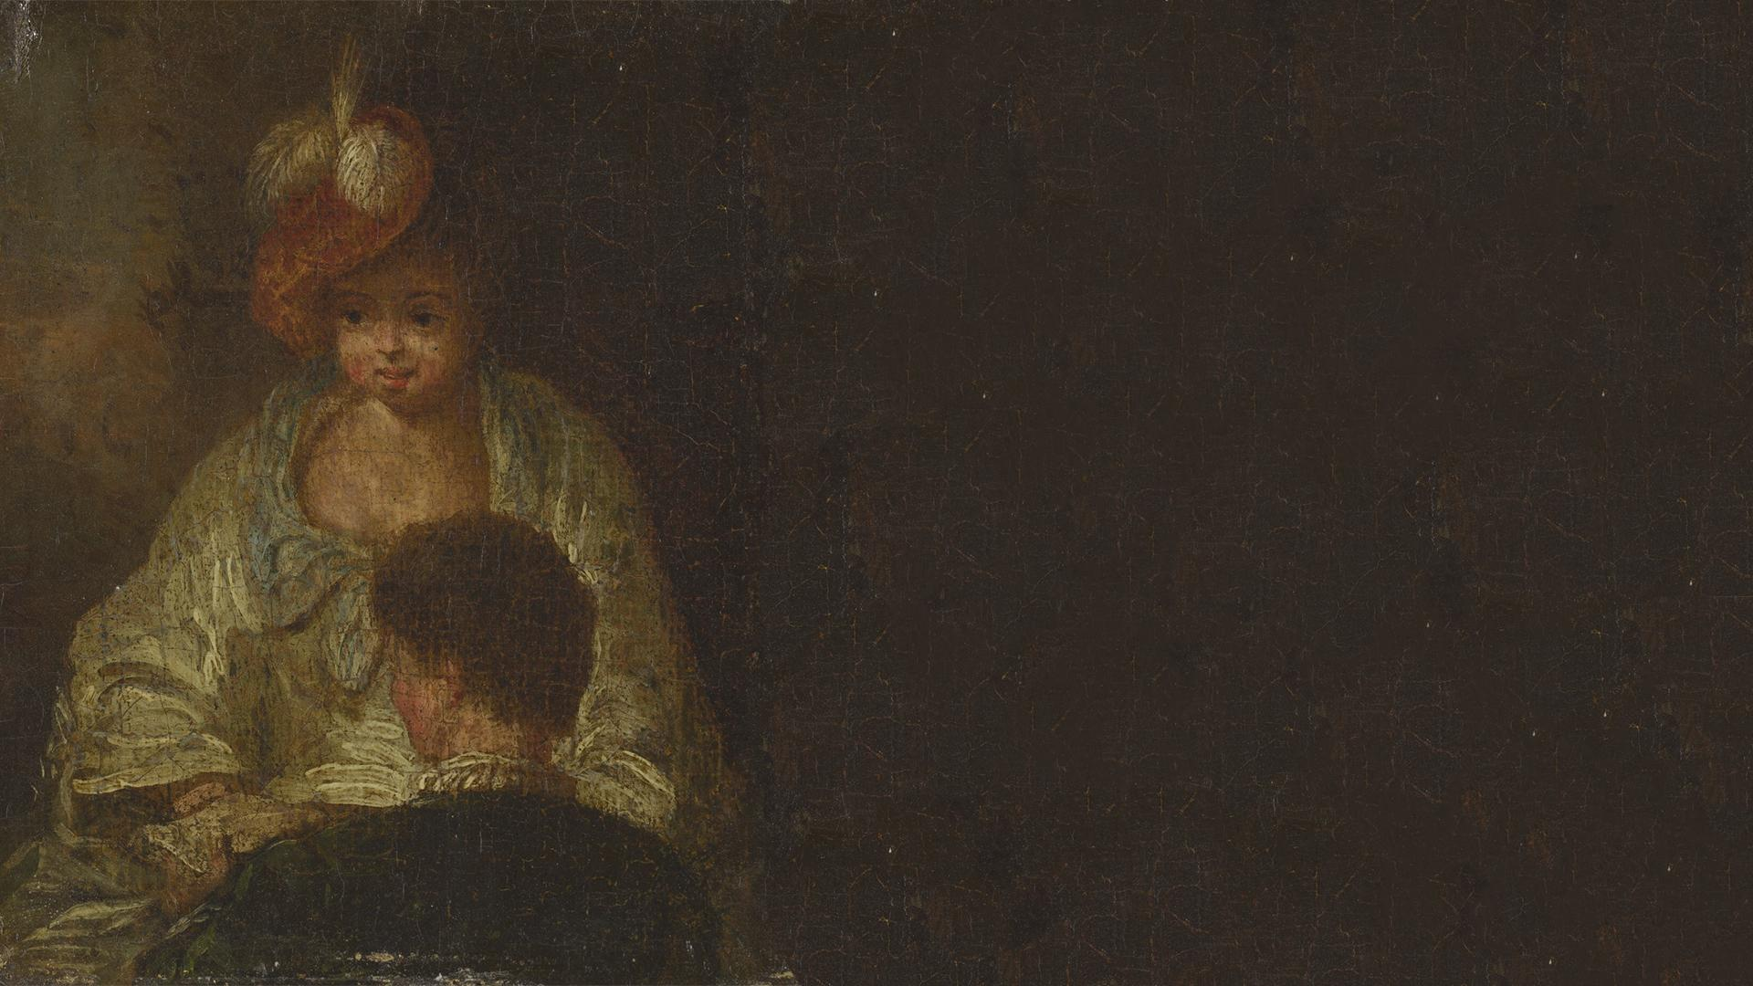
Whoa!
This can be the part of the presentation where you introduce yourself, write your email…

Slide 5
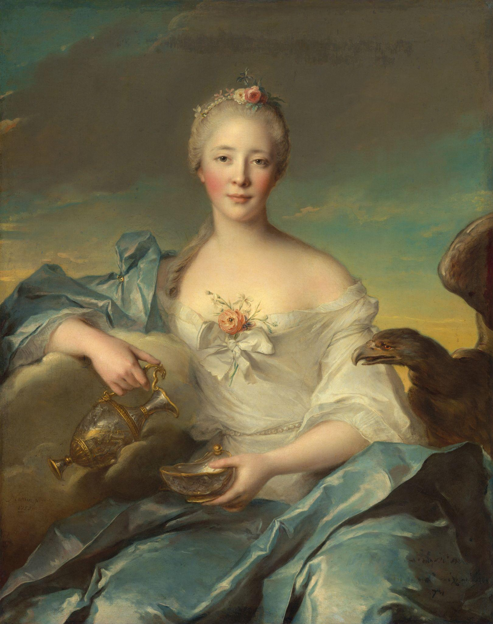
The slide title goes here!
Do you know what helps you make your point clear? Lists like this one:
They’re simple
You can organize your ideas clearly
You’ll never forget to buy milk!
And the most important thing: the audience won’t miss the point of your presentation

Slide 6
Let’s have a look
Mercury is the closest planet to the Sun and the smallest one in the entire Solar System. This planet’s name has nothing to do with the liquid metal, since Mercury was named after the Roman messenger god. Despite being closer to the Sun than Venus, its temperatures aren't as terribly hot as that planet’s. Its surface is quite similar to that of Earth’s Moon, which means there are a lot of craters and plains. Speaking of craters, many of them were named after artists or authors who made significant contributions to their respective fields. Mercury takes a little more than 58 days to complete its rotation, so try to imagine how long days must be there!

Slide 7
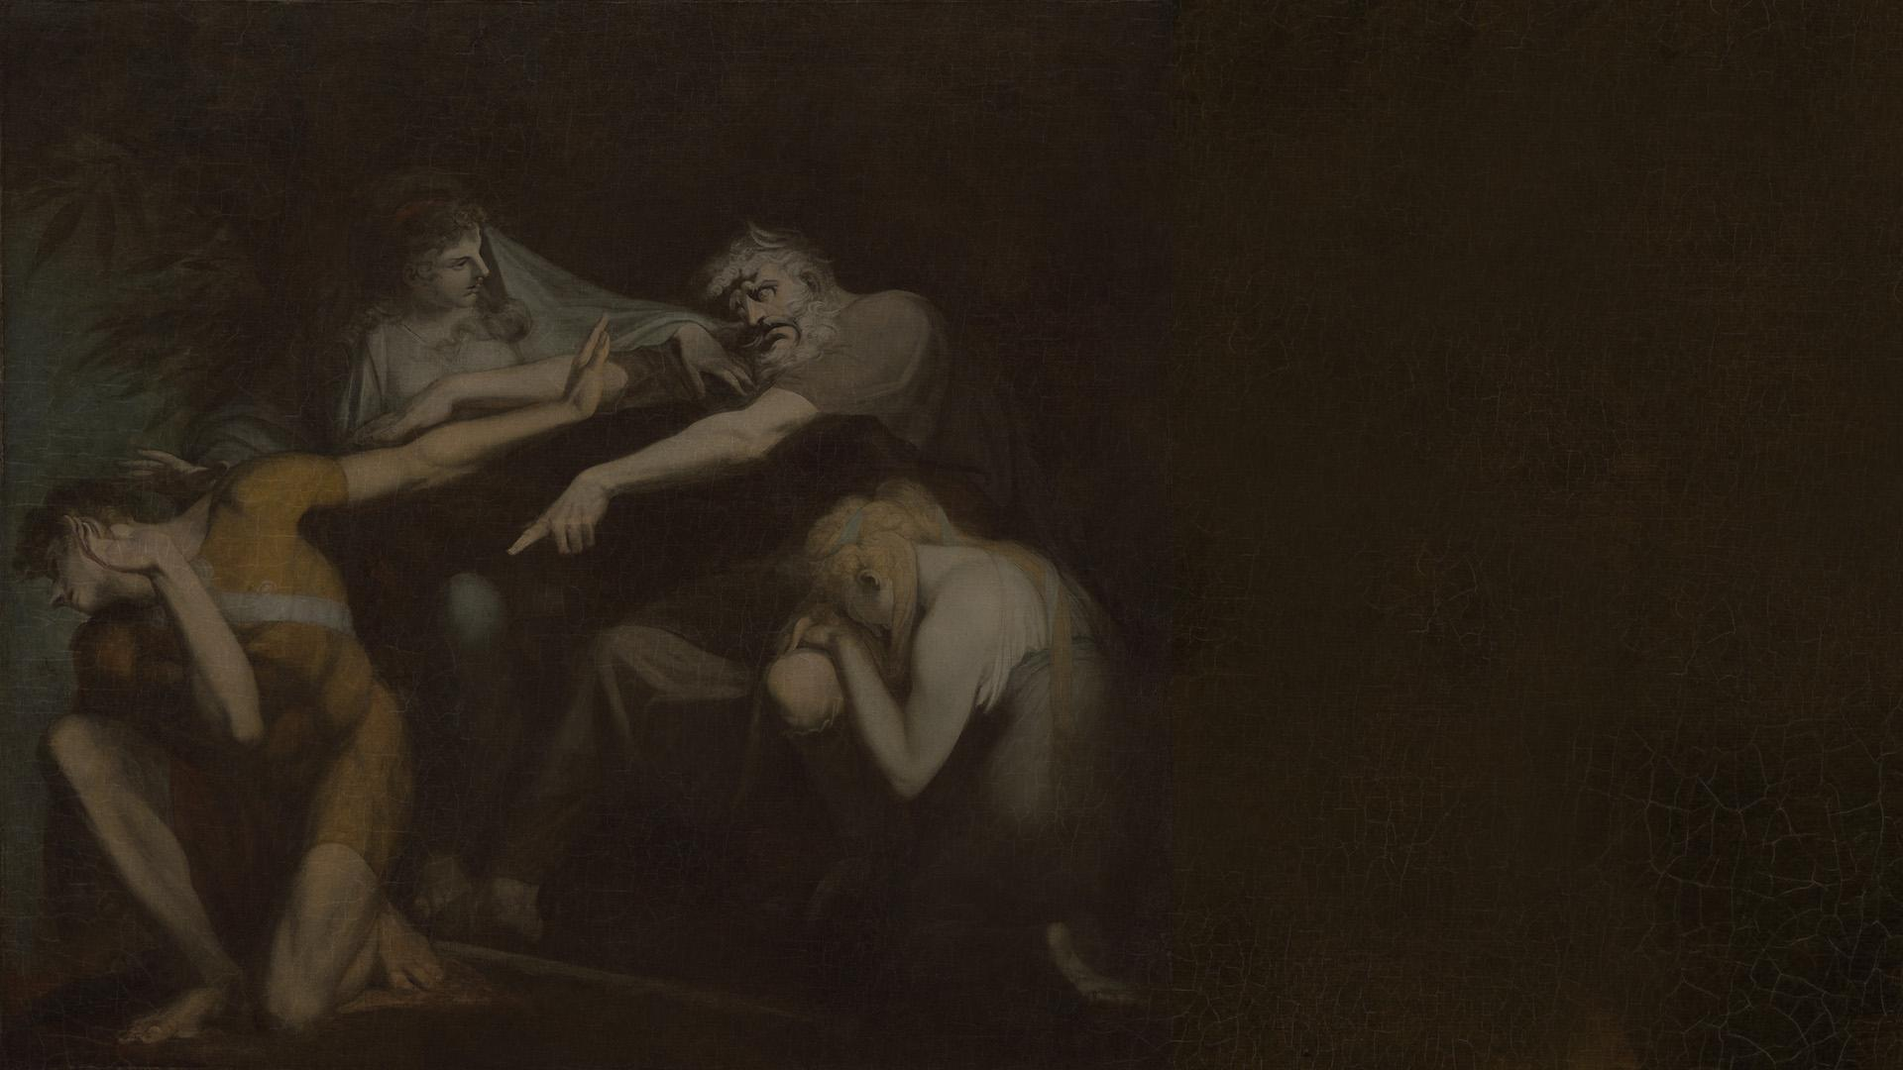
01
Gothic writing across time
You can enter a subtitle here if you need it

Slide 8
Suspense and horror: gothic writing across time
Mercury
Venus
Mercury is the closest planet to the Sun and the smallest one in the Solar System—it’s only a bit larger than the Moon
Venus has a beautiful name and is the second planet from the Sun. It’s hot and has a poisonous atmosphere

Slide 9
The Scarlet Letter
Written in 1850
Nathaniel Hawthorne
Set in New England
Mercury is the closest planet to the Sun and the smallest one in the Solar System
Venus has a beautiful name and is the second planet from the Sun
Despite being red, Mars is actually a cold place. It’s full of iron oxide dust

Slide 10
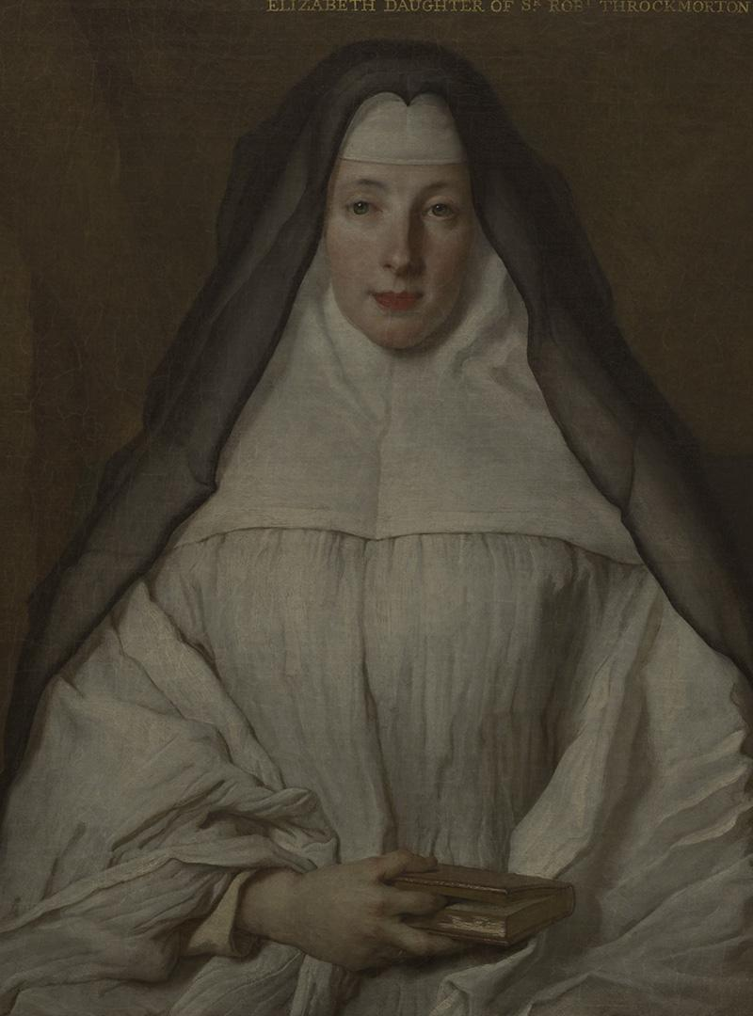
—Someone Famous
“This is a quote. Words full of wisdom that someone important said and can make the reader get inspired.”

Slide 11
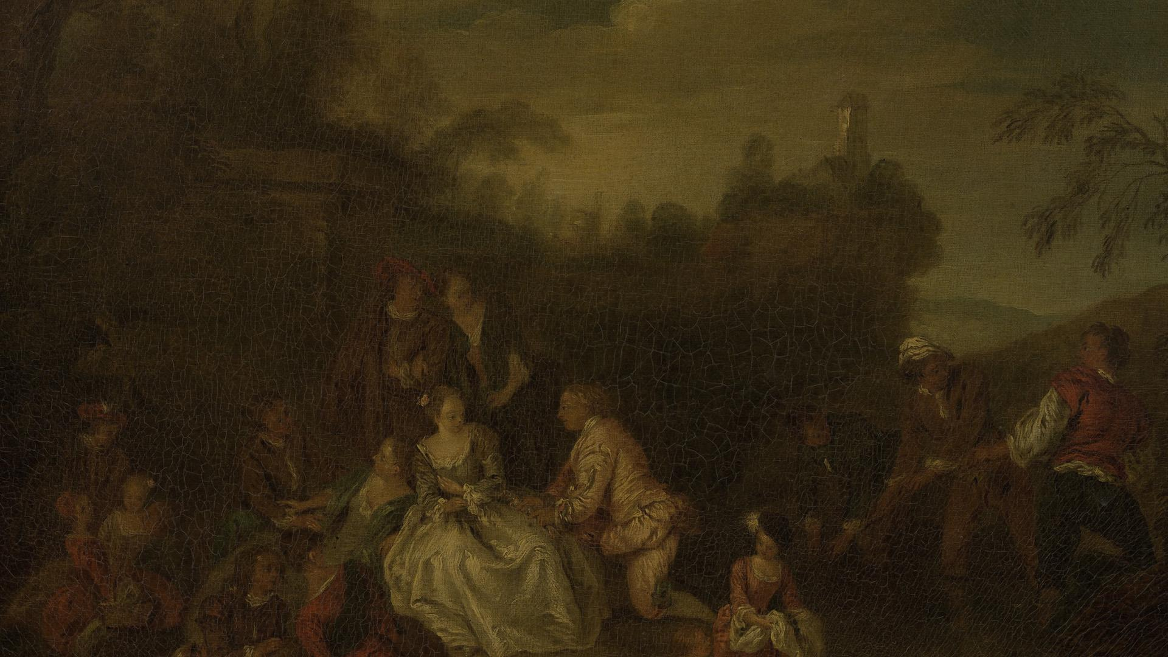
150,000
Big numbers catch your audience’s attention

Slide 12
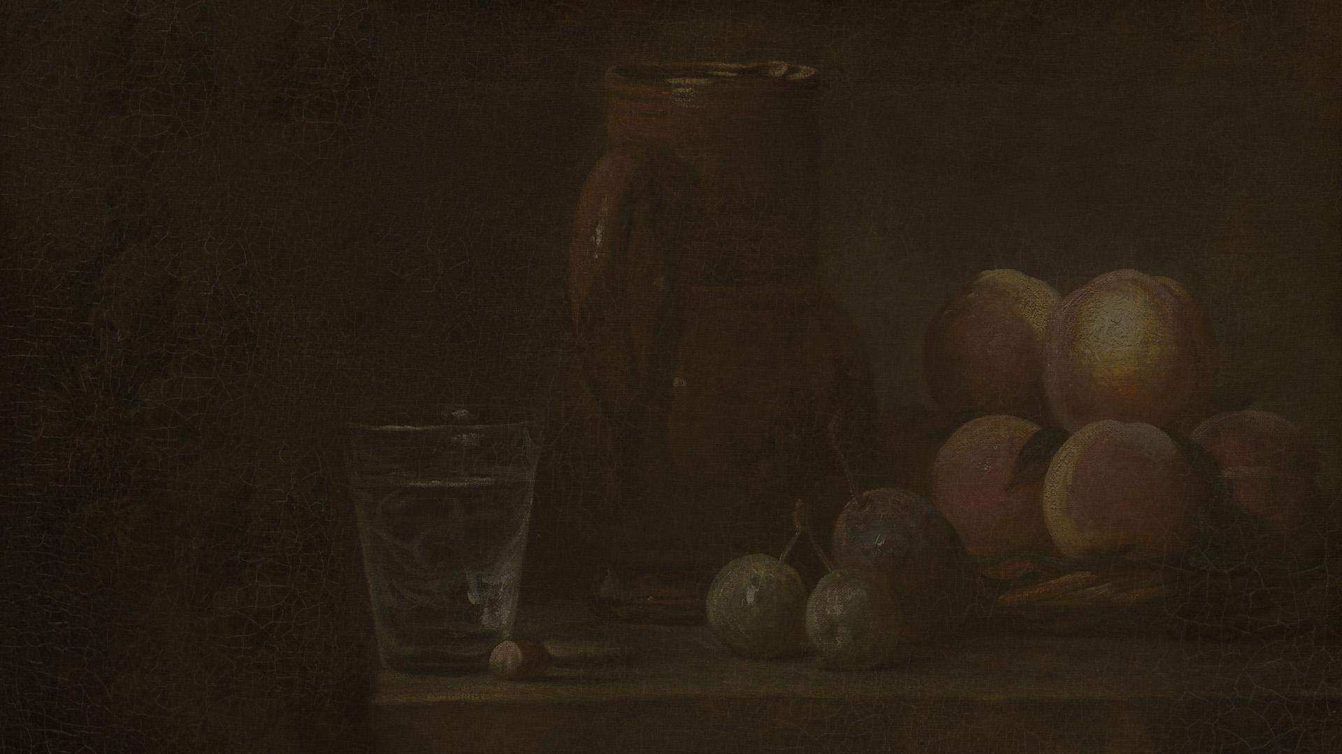
03
Symbols in Moby-Dick
You can enter a subtitle here if you need it

Slide 13
Moby-Dick symbolism
The gold doubloon
Sexual identity
W. Whale Moby Dick
Queequeg’s Coffin
Venus is the second planet from the Sun
Jupiter is the biggest planet in the Solar System
Despite being red, Mars is a very cold place
Saturn is a gas giant and has several rings

Slide 14
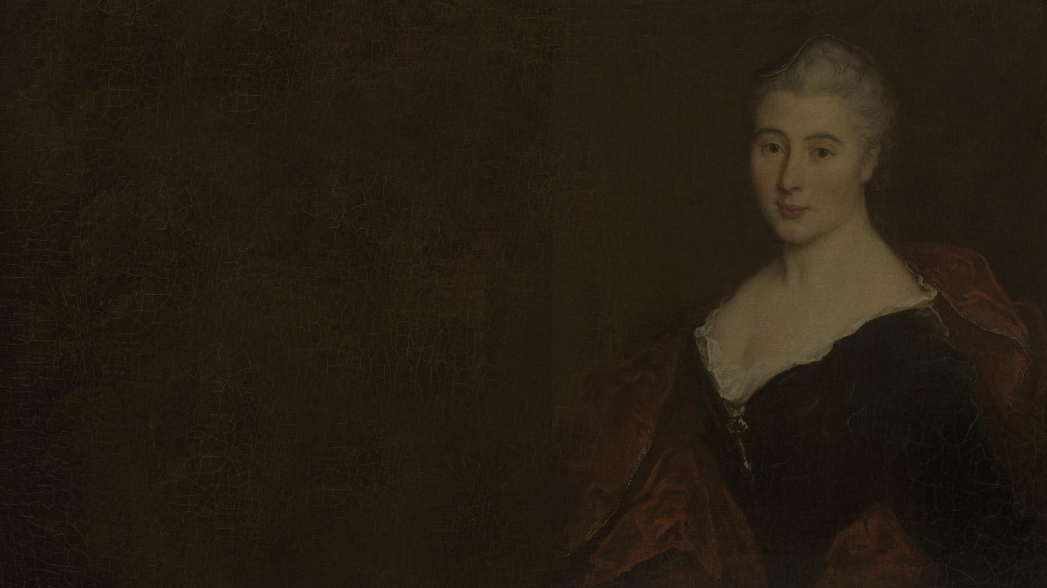
Awesome words

Slide 15
The dark romanticism
It has a beautiful name, but it’s terribly hot
Despite being red, Mars is a cold place, not hot
Venus
Mars
01
02
03
04
Mercury
Jupiter
Mercury is the closest planet to the Sun
Jupiter is the biggest planet of them all

Slide 16
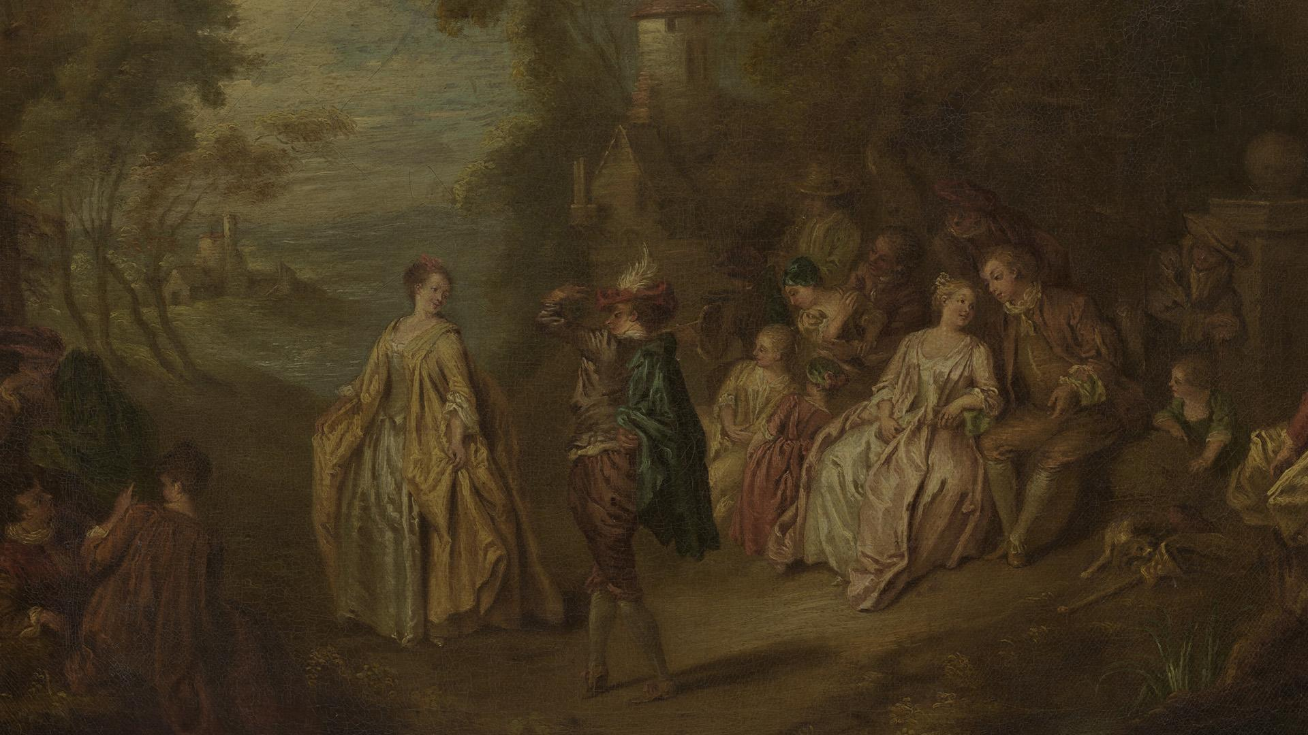
A picture is worth a thousand words

Slide 17
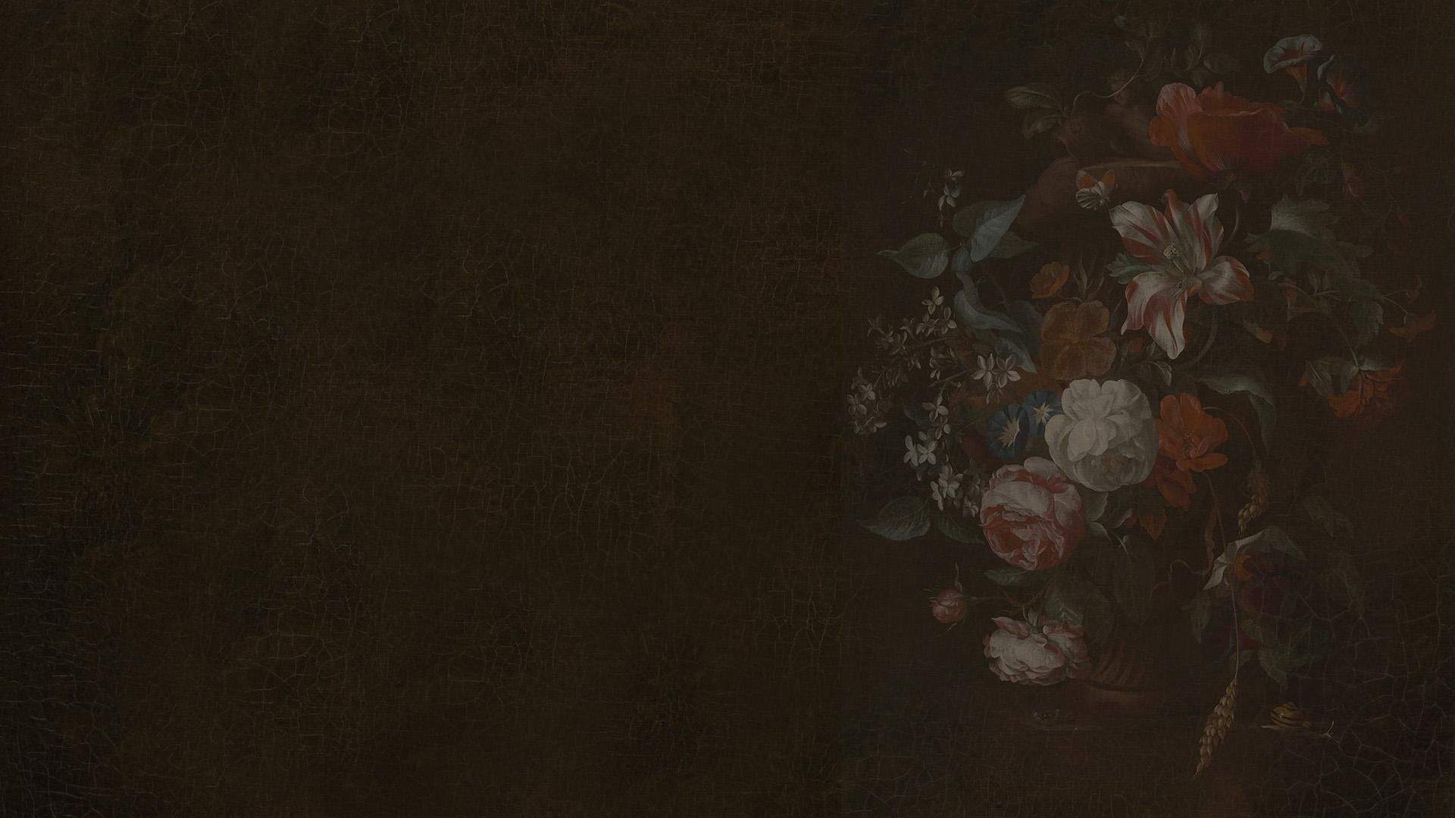
04
Edgar Allan Poe’s “Annabel Lee”
You can enter a subtitle here if you need it

Slide 18
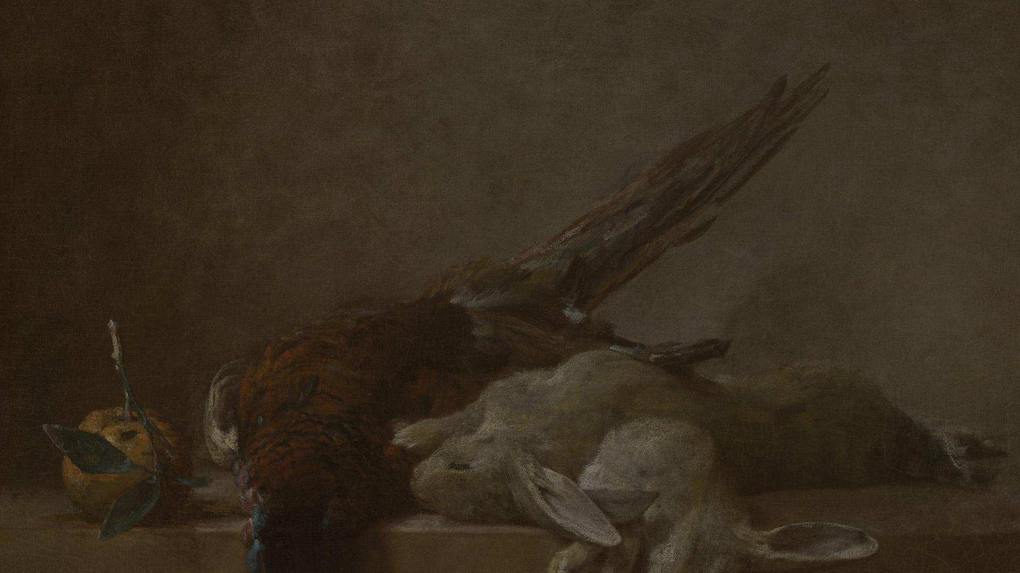
93,000 billion
333,000
9h 55m 23s
386,000 km
Light years is the size of the Universe
Earths is the Sun’s mass
Is Jupiter's rotation period
Is the distance between Earth and the Moon

Slide 19
The dark romantics
Romanticism
Mercury is the smallest planet
Venus is the second planet from the Sun
Mars is actually a very cold place
Dark romanticism
Jupiter is the biggest planet
Neptune is far away from Earth
Saturn is a gas giant with rings

Slide 20
Desktop mockup
You can replace the image on the screen with your own work. Just right-click on it and select “Replace image”

Slide 21
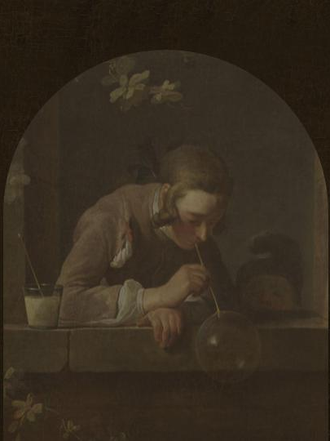
Tablet app
You can replace the image on the screen with your own work. Just right-click on it and select “Replace image”

Slide 22
Phone web
You can replace the image on the screen with your own work. Just right-click on it and select “Replace image”

Slide 23
Annabel Lee, Edgar Allan Poe
Mars
Venus
Neptune
Mercury
Saturn
Jupiter
Despite being red, Mars is actually a cold place
Venus is the second planet from the Sun
Neptune is the farthest planet from the Sun
Mercury is the closest planet to the Sun
Saturn is a gas giant and has several rings
Jupiter is the biggest planet of them all

Slide 24
Let’s use some percentages
25%
50%
75%
Mercury
Venus
Mars
It’s the closest planet to the Sun and the smallest one in the Solar System
Venus has a beautiful name and is the second planet from the Sun
Despite being red, Mars is actually a cold place. It’s full of iron oxide dust

Slide 25
This is an infographic
Mars
Neptune
a
a
c
Mars is actually a very cold place
It’s the farthest planet from the Sun
Mercury
Saturn
d
b
d
It’s the closest planet to the Sun
Saturn is a gas giant with several rings
b
c

Slide 26
This is a map
Venus
It has a beautiful name, but it’s terribly hot
Mercury
Mercury is the closest planet to the Sun
Mars
Despite being red, Mars is a cold place, not hot

Slide 27
Chronological order
1840
1849
1850
1851
The Fall of the House of Usher
Annabel Lee
The Scarlet Letter
Moby-Dick

Slide 28
A picture always reinforces the concept
Images reveal large amounts of data, so remember: use an image instead of a long text. Your audience will appreciate it

Slide 29
Choosing vocabulary
Vocabulary of dark romanticism
Mercury |  | Mercury is the closest planet to the Sun and the smallest one in the Solar System
Venus |  | Venus has a beautiful name and is the second planet from the Sun. It’s terribly hot
Saturn |  | Saturn is a gas giant and has several rings. It’s composed mostly of hydrogen and helium

Slide 30
The authors
Nathaniel Hawthorne
Herman Melville
Edgar Allan Poe
You can speak a bit about this person here
You can speak a bit about this person here
You can speak a bit about this person here

Slide 31
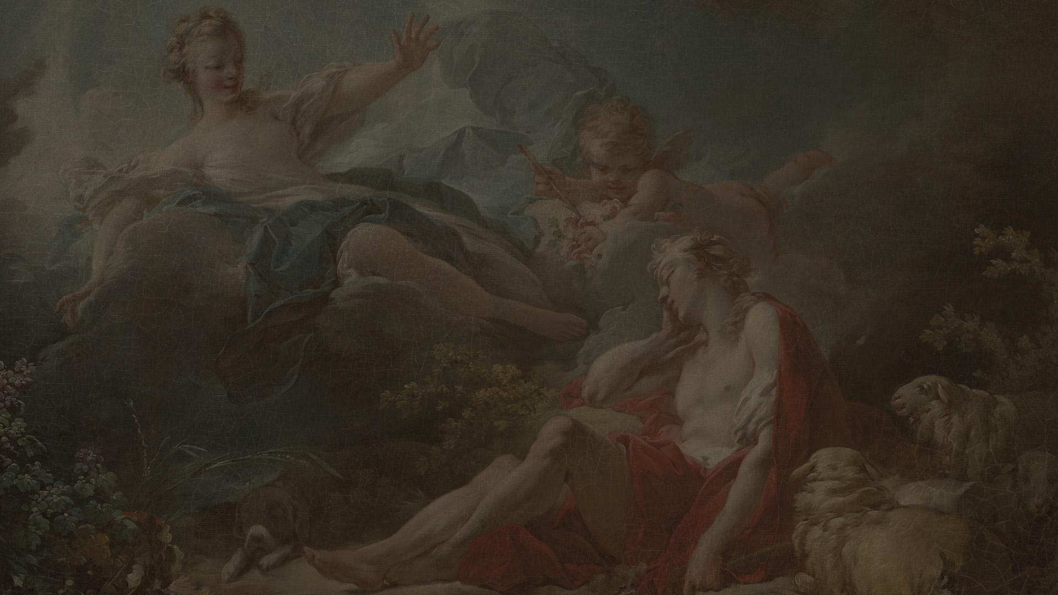
THANKS!
Does anyone have any questions?
addyouremail@freepik.com
+91 620 421 838
yourcompany.com
Please keep this slide for attribution

